Slide 1


Slide 2

Music industry has a great potential to create jobs…

Slide 3
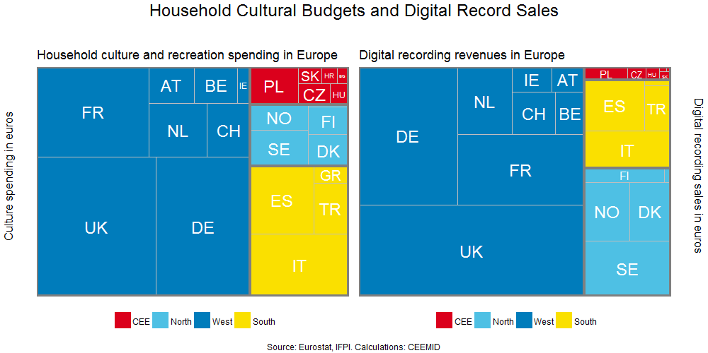
There is a lot of room for growth in the region

Slide 4
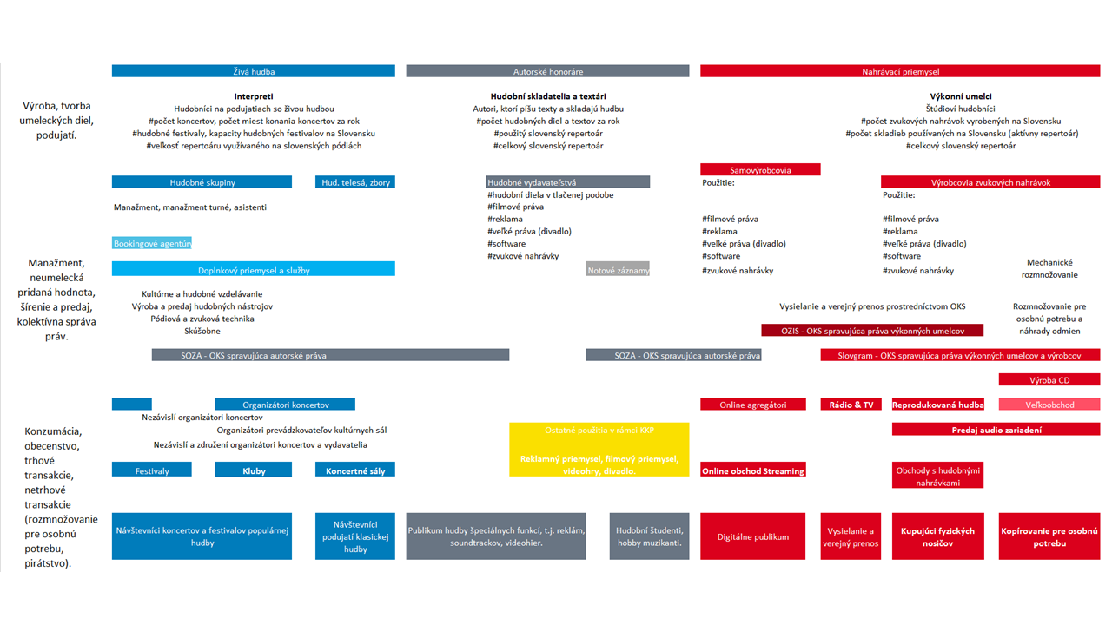
Creating a program for national music industry growth
The Slovak music industry is relatively small but has many organizations. In the global competition it can be competitive only if it follows a joint strategic plan that aligns the long-term interests of artists, technicians, managers, promoters, publishers, labels, collective management and granting authorities.

Slide 5
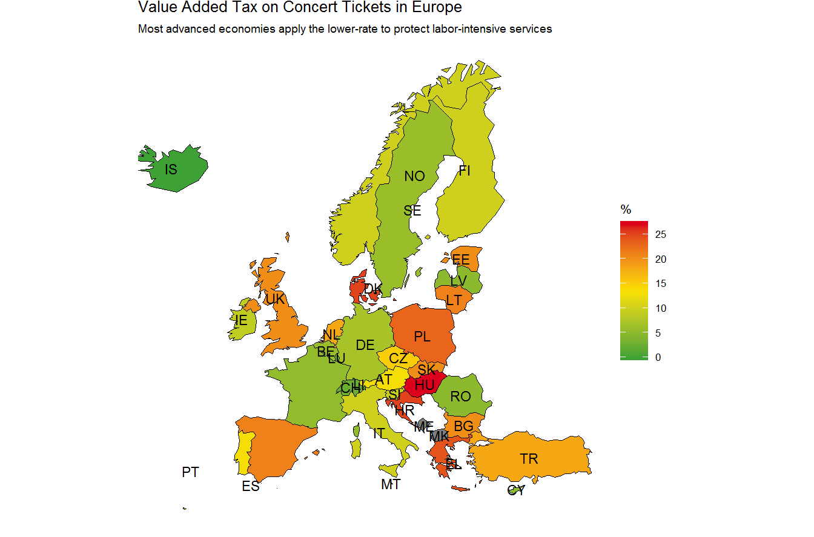
New VAT regulation concentrating on jobs and tax base

Slide 6
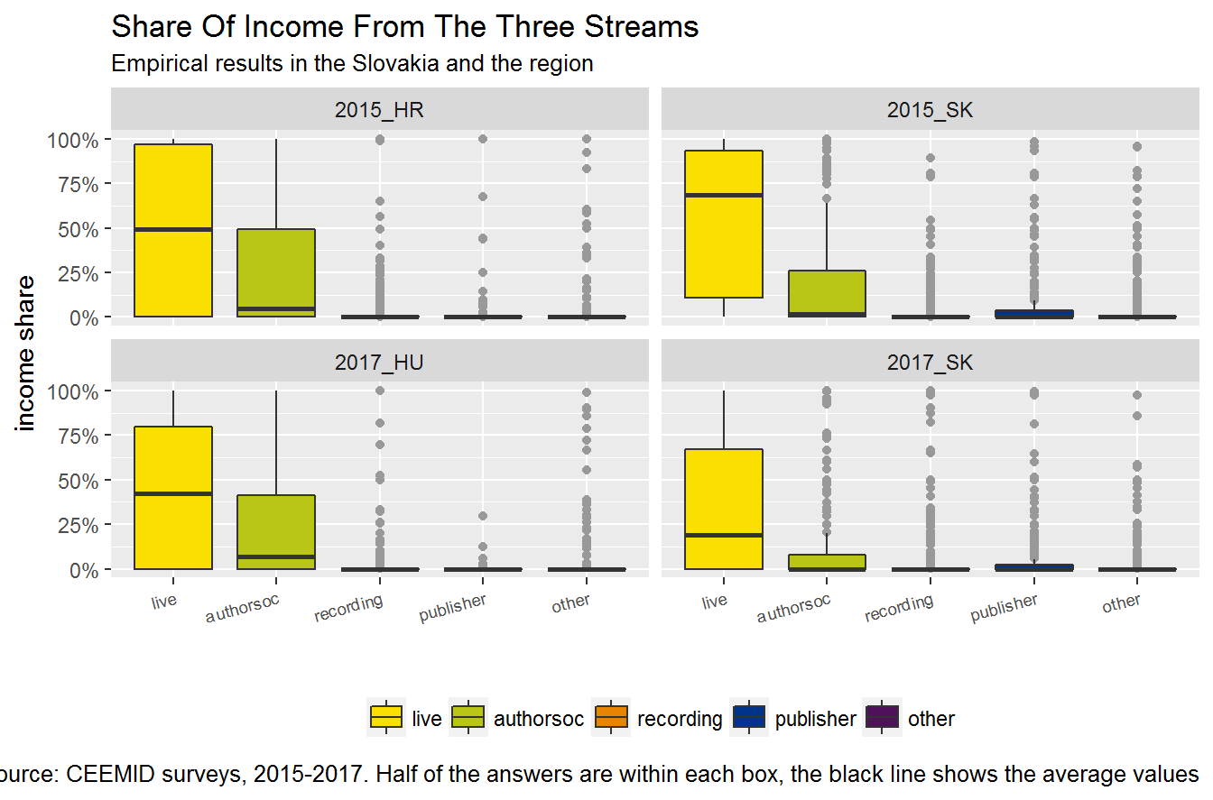
Stronger copyright protection and higher royalty values

Slide 7
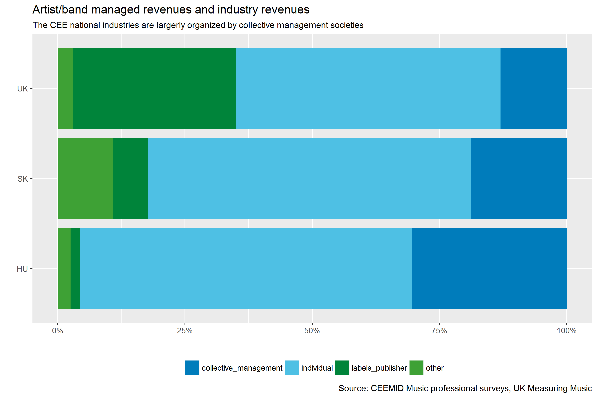
Critical size in the global market requires strong national players

Slide 8
Long-term growth in the domestic market
Animation starts only in viewer mode
Music discovery:
Young people visit most frequently.
Mature :
Middle-aged can spend more money
Older:
Older audiences have most time

Slide 9

Short-term growth with foreign revenues

Slide 10
Get involved
musicindustry@sharpe.sk
Tomas.Miks@soza.sk
Daniel.Antal@ceemid.eu

